Slide 1
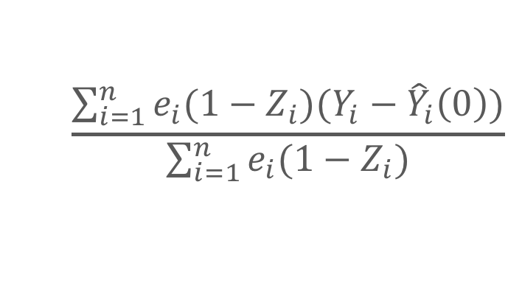
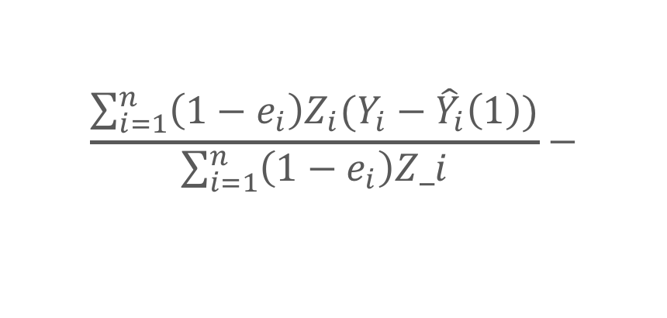
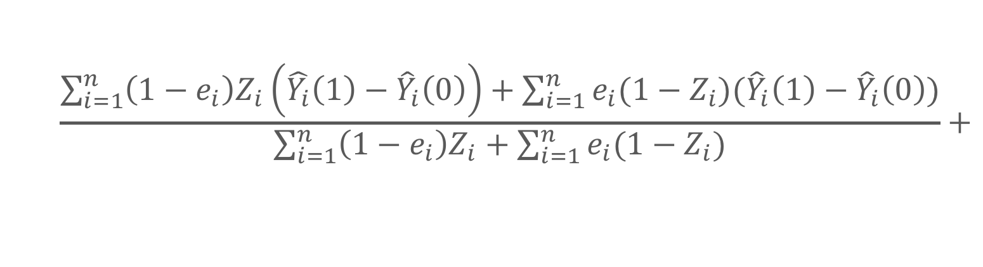
1.
weighting
2.
regression
50%
50%
20%
50%
~ star wars + blue
Hedge your bets
drawing conclusions from non-randomized studies
$$\frac{\sum_{i=1}^{n}{\left(1−e_{i}\right)Z_{i}\left(\hat{Y_{i}}\left(1\right)−{\hat{Y}}_{i}\left(0\right)\right)+\sum_{i=1}^{n}{e_{i}(1−Z_{i})({\hat{Y}}_{i}\left(1\right)−{\hat{Y}}_{i}\left(0\right))}}}{\sum_{i=1}^{n}{\left(1−e_{i}\right)Z_{i}+\sum_{i=1}^{n}{e_{i}(1−Z_{i})}}}+$$
weighting
regression
regression
weighting
$$\frac{\sum_{i=1}^{n}{\left(1−e_{i}\right)Z_{i}(Y_{i}−{\hat{Y}}_{i}\left(1\right))}}{\sum_{i=1}^{n}{\left(1−e_{i}\right)Z_i}}−$$
$$\frac{\sum_{i=1}^{n}{e_{i}(1−Z_{i})(Y_{i}−{\hat{Y}}_{i}\left(0\right))}}{\sum_{i=1}^{n}{e_{i}(1−Z_{i})}}$$
LUCY D’AGOSTINO MCGOWAN
Notes:
Let’s set up a study. You go to a movie theater and hand everyone exiting a survey asking which movie they saw and how happy they are feeling on a scale of 1 to 5. You are interested in assessing whether folks who saw Star Wars are happier than people who saw something else. We’ve just set up what’s called an “observational study”. It’s different from a randomized study because we are not randomly assigning people to an exposure (so in this case we are not randomly giving people tickets to see Star Wars or something else as they enter) we are simply observing what has happened after the fact. The blue square on the top represents the data I’ve collected on these movie goers – in the white circle I have my Star Wars viewers and in the pink circle I have everyone else. Notice there are two types of people, purple people and blue people. Proportionally, I have fewer blue people in the Star Wars group – let’s say the blue people are predisposed to be sad -- this can cause a problem when I am trying to assess the effect because maybe my Star Wars people will look happier simply because there are fewer people who are predisposed to be sad in that group, not because they just saw Star Wars. I research ways to deal with these biases in an observational study setting. One way to handle this is to weight the groups so they are balanced before estimating the effect of interest – in this case we would upweight the blue people in the Star Wars group to match the proportion in the other group. A second way to deal with this is to fit a regression model where we predict happiness based on the film you saw adjusting for additional features, such as being blue. Rather than choosing between these methods, we allow you to ‘hedge your bets” - I have derived what’s known as a doubly robust estimator where you can use both weighting and regression to attempt to get the correct estimate, and as long as one of the two is correct, your estimate will be unbiased. Our doubly robust estimator is for a weight that has great properties, like it works well even in small samples. This has real significance, not just for answering important questions like does watching Star Wars make you happy, but for questions like does a certain diabetes drug have protective effects against certain types of cancer or does a certain drug reduce your risk of heart failure. With the increase in the availability of big data, methods to answer questions in an observational study setting are becoming increasingly more crucial, our doubly robust estimator that allows researchers to hedge their bets by attempting to account for bias via both weighting and regression methods does just that.

